Slide 1
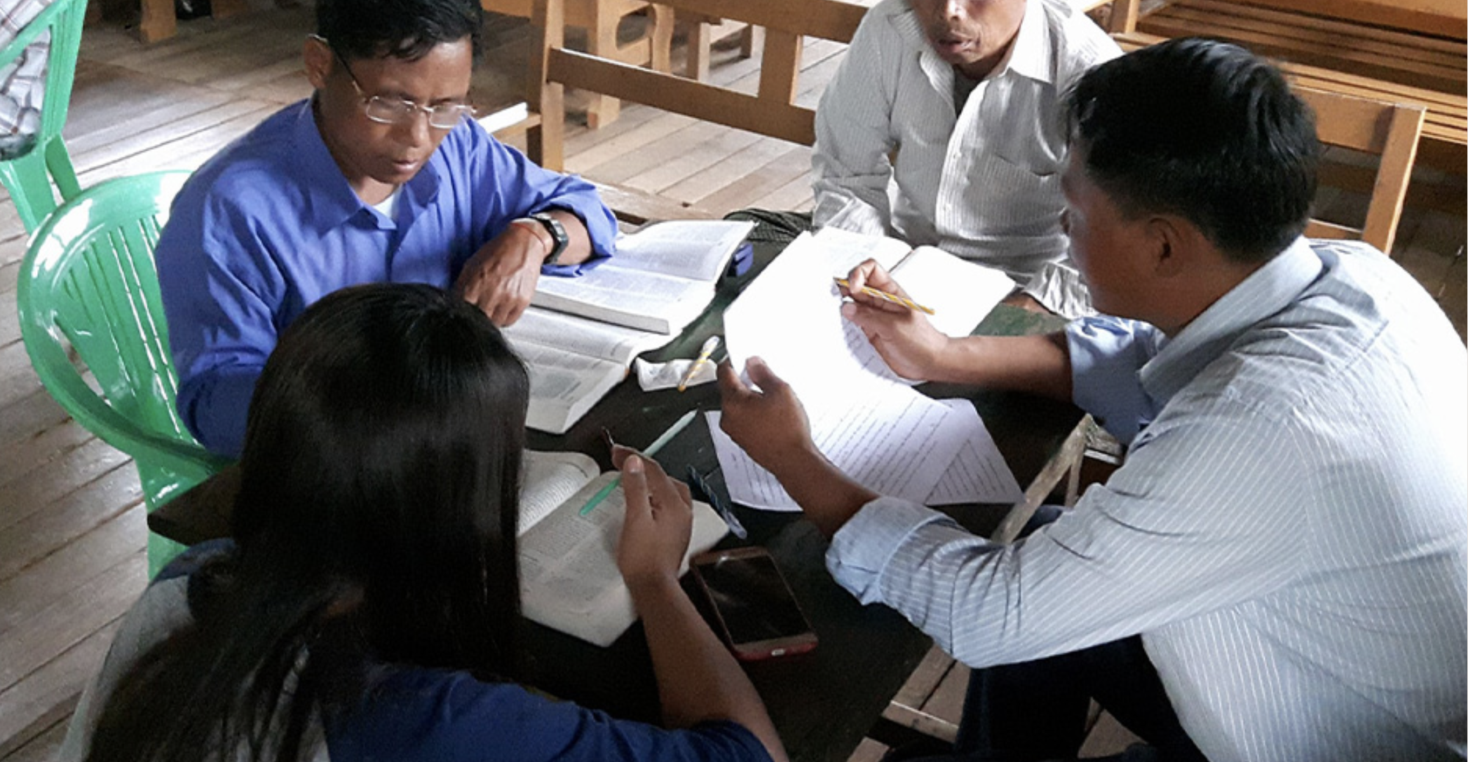
Checking Steps

Slide 2
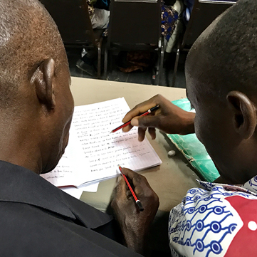

The Eight-Step Translation Method
Drafting Steps
Checking Steps
Consume
Verbalize
Chunk
Blind Draft
Self-edit
Peer-edit
Key Word Check
Verse-by-Verse Check

Slide 3
Step 5: Self-Edit
No
time limit
Alone
Each one should examine his own work... Galatians 6:4a
  Process: 1. Compare your draft to the source text
  2. Make any needed changes
Benefits:
  Any missing, added, or incorrect information can be corrected
  You retain ownership and responsibility for your draft
  Tip: Use your Quality Assessment Guide to make sure your draft meets every quality you desire in your translation.
  Use as many resources as you have available.

Slide 4
Step 6: Peer-Check
No
time limit
With a partner
Two people work better than one; together they can earn a good wage for their labor. Ecclesiastes 4:9
  Process: 1. A partner compares your draft to the source text
  2. The partner asks questions and suggests edits
  3. Discuss changes, asking others for input if needed
  4. Make the changes you agree on
Benefits:
  Others often catch mistakes you miss
  A partner can tell if your translation is easy to understand
  You retain ownership and responsibility for your draft
Tips: Make sure to read the translation out loud.
Use all resources available.
Check that the meaning is clearly communicated.

Slide 5
Step 7: Key Word Check
No
time limit
With a new partner
But the one to whom I have declared something, let him declare my word truthfully. Jeremiah 23:28b
Process: 1. A partner marks all the key words and key terms in the source text
2. Check that every one of these words is in the draft
3. Check that the definitions of these words in the draft communicate the same meaning as the definitions of the words in the source text.
Benefits:
  Ensures meaning-based translation
  Begins the process of consistency checking
  Verifies theological accuracy
  Helps teams find the best way to convey spiritual concepts
  Improves clarity and accuracy
Tips: The translation may need to use more than one word to express the same meaning as a key word or a key term.
Keep a list of the words that are difficult to express in your language for your whole team to use. Include the translations you chose for each word.

Slide 6
Step 8: Verse-by-Verse Check
No
time limit
With two new partners
Iron sharpens iron; in the same way, a man sharpens his friend. Proverbs 27:17
Process: 1. Read the translation aloud
2. One partner orally translates it back into the source language
3. The second partner compares the oral back-translation to the
source text
4. The three discuss differences and make corrections
Benefits:
  New readers/listeners may notice small problems that others missed
  Accuracy and meaning are more closely examined
  Flow, clarity, and naturalness are all affirmed

Slide 7
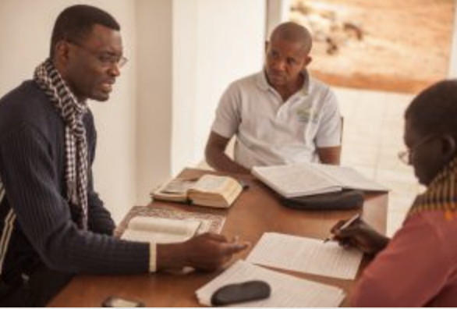
Checking Steps Summarized
5
6
7
8
Self-edit
Peer-edit
Key Word
Check
Verse-by-Verse Check
Compare each
chunk to source;
make any edits
Another
translator
compares and suggests edits
Work with a partner
to ensure that
the key words
are clear
Translator reads each verse of translation aloud
Checker 1, out loud, translates each verse back into the source language
Checker 2 listens and looks at source text to compare

Slide 8
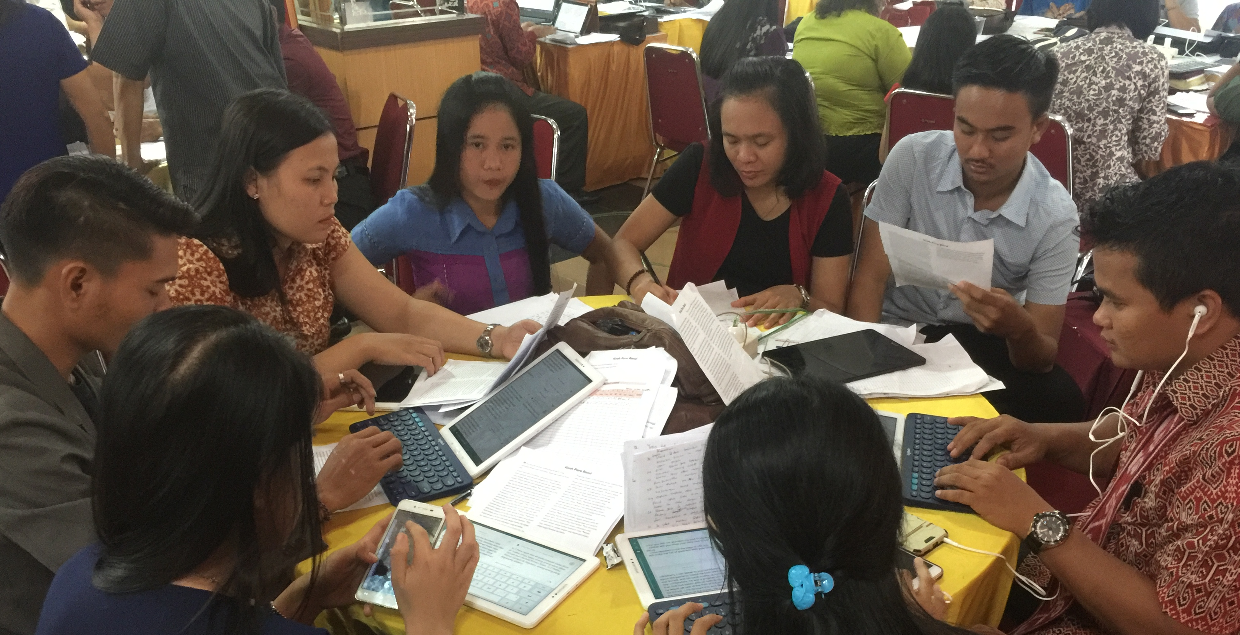
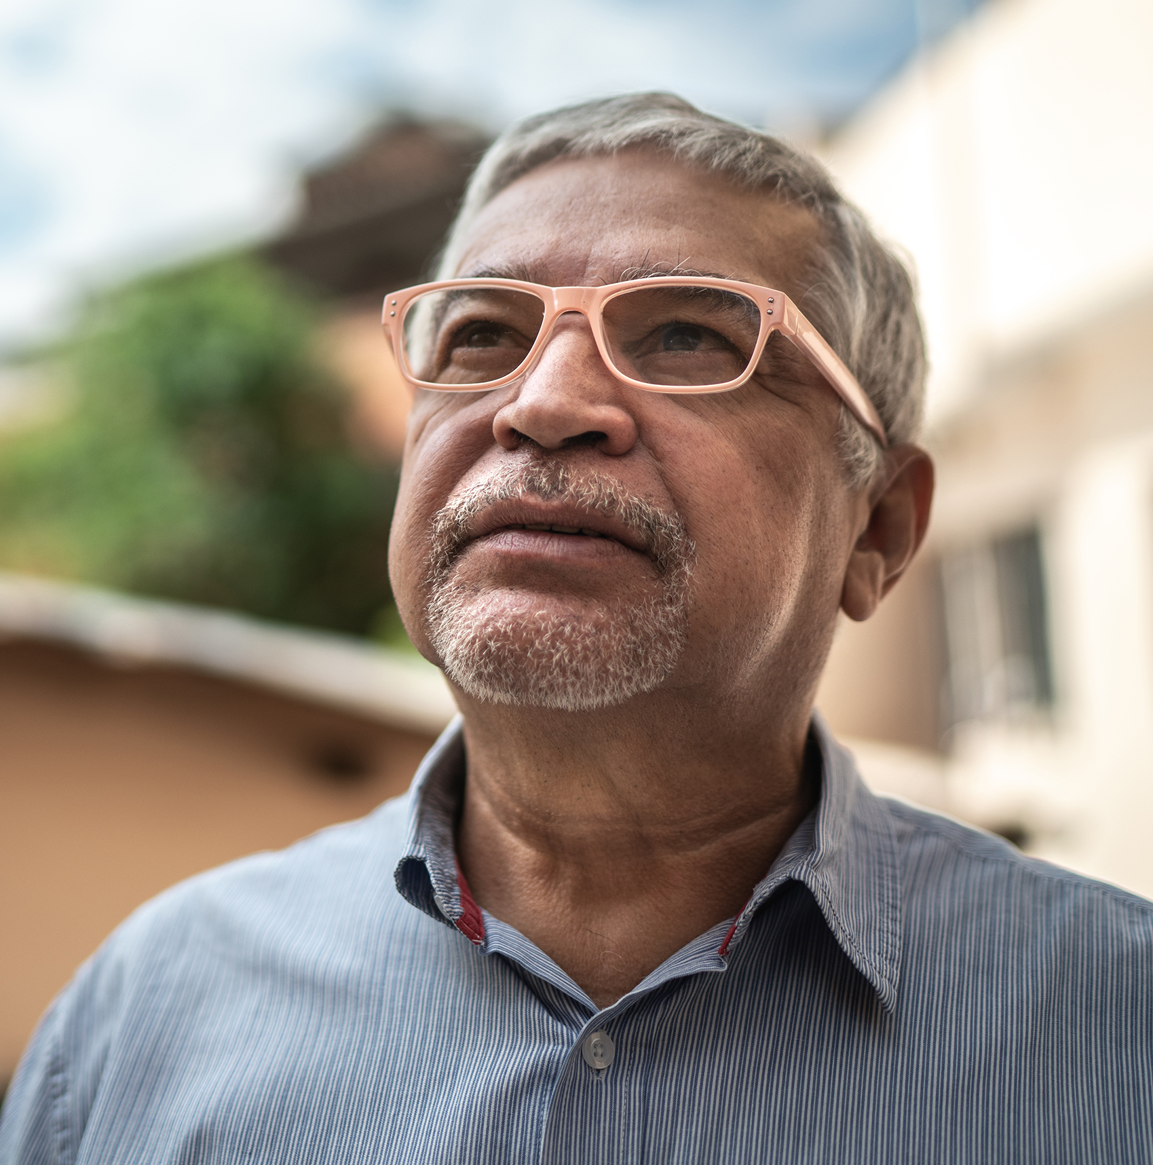
The checking steps have no time limit …
a great time for discussion and research to improve the text
Make changes as needed . . .
. . . praying for God’s guidance

Slide 9
Try it
Check the work translated in last session
Did the checking steps improve the text?
Were there many errors?

Slide 10
?
What happens if you skip steps?

Slide 11

Checking Step 7:
Key Words

Slide 12
?
How would you define
a key word?

Slide 13
A strong impact on meaning
Abstract words
Spiritual
terms
Often repeated for emphasis

Slide 14
?
What earlier steps
might reveal errors?
Why target these words?
Often
no precise equivalent
Often hard to translate

Slide 15
For God so loved the world, that he gave his only Son, that whoever believes in him will not perish but have eternal life.
John 3:16 (ULB)

Slide 16
For God so loved the world, that he gave his only Son, that whoever believes in him will not perish but have eternal life.
John 3:16 (ULB)

Slide 17
Try it
Luke 17

Slide 18
Discuss
?
Are the lists the same?
Are some words on everyone’s lists?
Why the differences?

Slide 19
What to do with the key word list
Check translation for each key word.
Discuss difficult words and choose how to translate.
Create list to be used by all translators.

Slide 20

All Scripture taken from the English Unlocked Literal Bible (ULB), ©2017, 2022 Wycliffe Associates, Available at https://bibleineverylanguage.org/translations, licensed under the Creative Commons Attribution-ShareAlike 4.0 International License.
The English ULB is based on the unfoldingWord® Literal Text, CC BY-SA 4.0. The original work of the unfoldingWord® Literal Text is available at https://unfoldingword.bible/ult/.

